Slide 1





Prometheus Interactive Workshop
This workshop is being recorded
All registrants will receive access to the recording
Presenter will take questions at the end

Slide 2


Grafana Labs:
Prometheus & more
Interactive Workshop

Slide 3





Ronald McCollam, Solutions Engineer,
Stole fire from the gods first, but dropped it because he forgot to steal hot pads
@rm@amaseto.com
@RonaldMcCollam
https://hackaday.io/ronaldmccollam
www.linkedin.com/in/mccollam

Slide 4

Mike Johnson, Solutions Engineer
The only person in history to believe watching baseball on TV is NOT boring
New Guitarist Wannabe
@mikempx
https://www.linkedin.com/in/mj-at-grafana/

Slide 5

Eldin
Capricorn
Unimpressed at how accurate astrology is
Doesn't believe in ghosts
Believes in whisky
@nikoalch
https://www.linkedin.com/in/eldin-nikocevic/

Slide 6
PROMETHEUS INTERACTIVE WORKSHOP Agenda
Prometheus Introduction
Hands-on breakout Prometheus UI & Queries
PromQL
Hands-on breakout
PromQL, Grafana Explore, & Dashboarding
Advanced Topics

Slide 7

Meet your team
Introduce yourself to your breakout group!

Slide 8
Poll Q

Slide 9

Observe and check the progress or quality of something over a period of time
View, Debug, & Alert
Trends over time

Slide 10

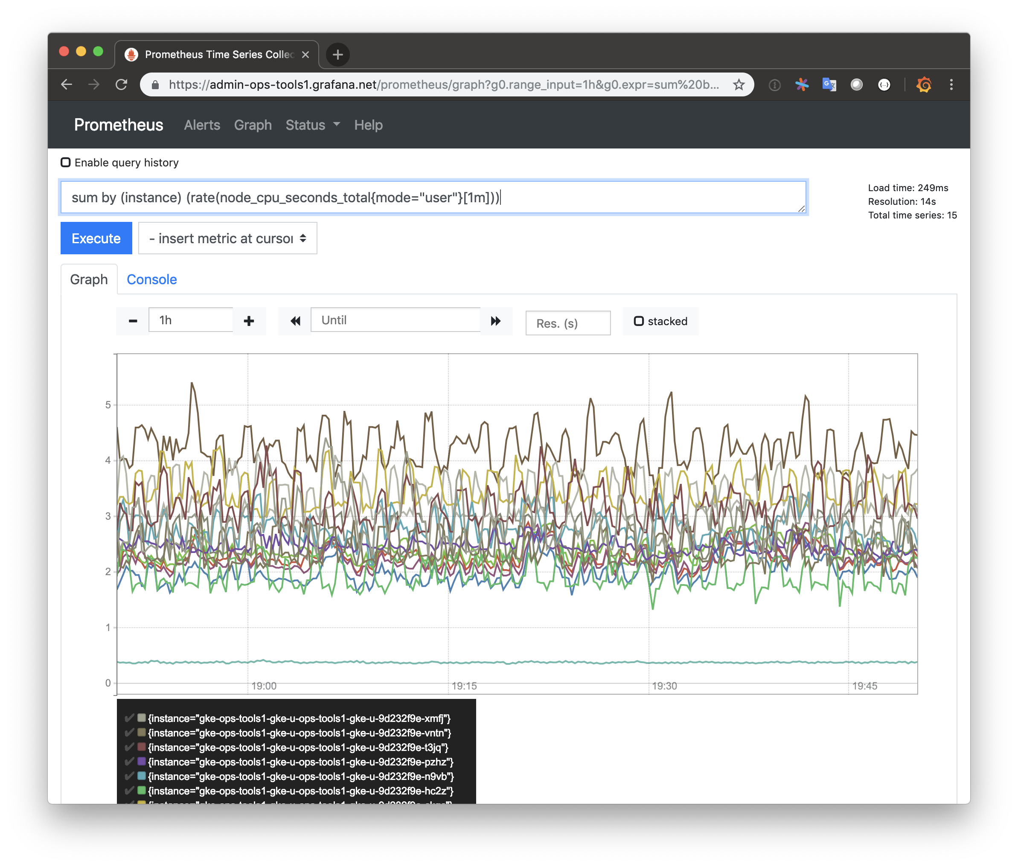
The Prometheus Monitoring System
A pull-based monitoring system with dynamic service discovery, built for the cloud.
A powerful query language and multidimensional data model for rich, ad hoc analysis.
Open source, incredibly resource efficient and simple to operate.

Slide 11





Cloud Native
Prometheus pulls (“scrapes”) metrics from jobs.
Service Discovery is source-of-truth for jobs existence.
Jobs can be natively instrumented jobs + or use adapters (“exporters”).

Slide 12
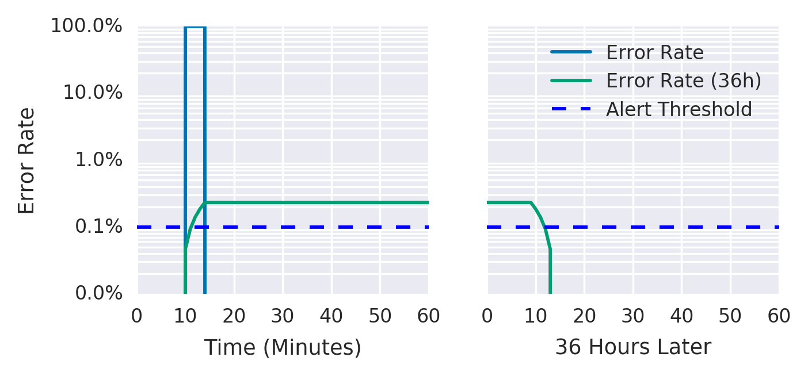
Rich Analysis
Combine app & infra metrics for capacity planning
rate(container_cpu_usage_seconds_total[1m])
/
rate(request_count[1m])
SLO Alerting to reduce pager fatigue
slo_errors_total{job=”frontend”} 145
Join app metrics & metadata to monitor rollouts
... rate(request_count[1m]) ...
* on (instance) group_left (image)
... kube_pod_container_info ...
Figure 5-2. Error rate over a 36-hour period
https://landing.google.com/sre/workbook/chapters/alerting-on-slos/

Slide 13
Recap
Trusted: open source, Apache licensed and vendor neutral
Run anywhere: single binary with no dependencies
Incredibly efficient: monitor thousands of machines with a single Prometheus

Slide 14
Poll Q

Slide 15
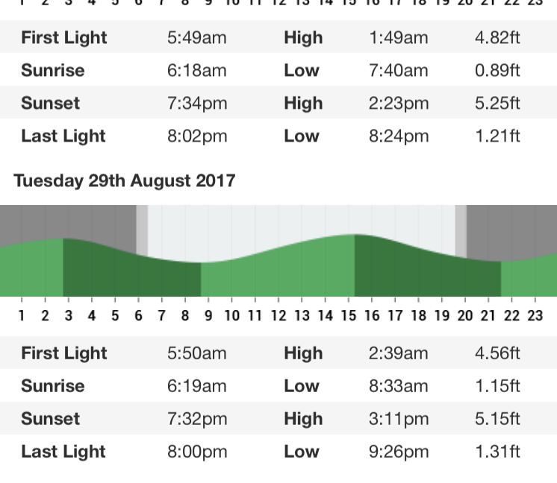
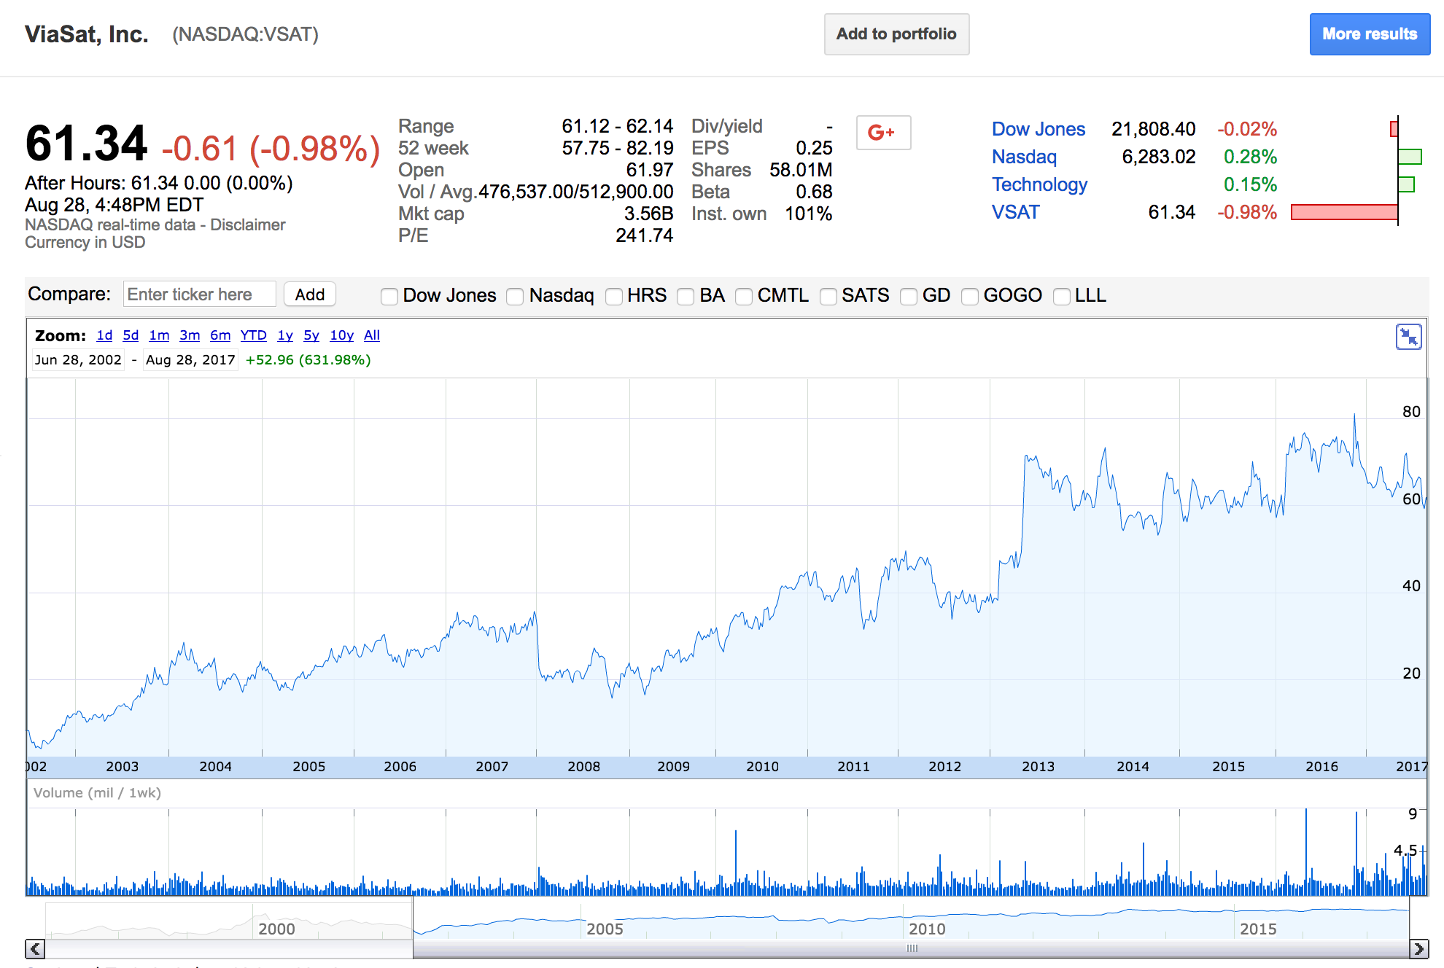
Time Series Data
It’s measurement data stored with a time stamp
It’s typically regular increments of data points over time
Conducive to mathematical functions, capacity planning, predictions, and alerting

Slide 16
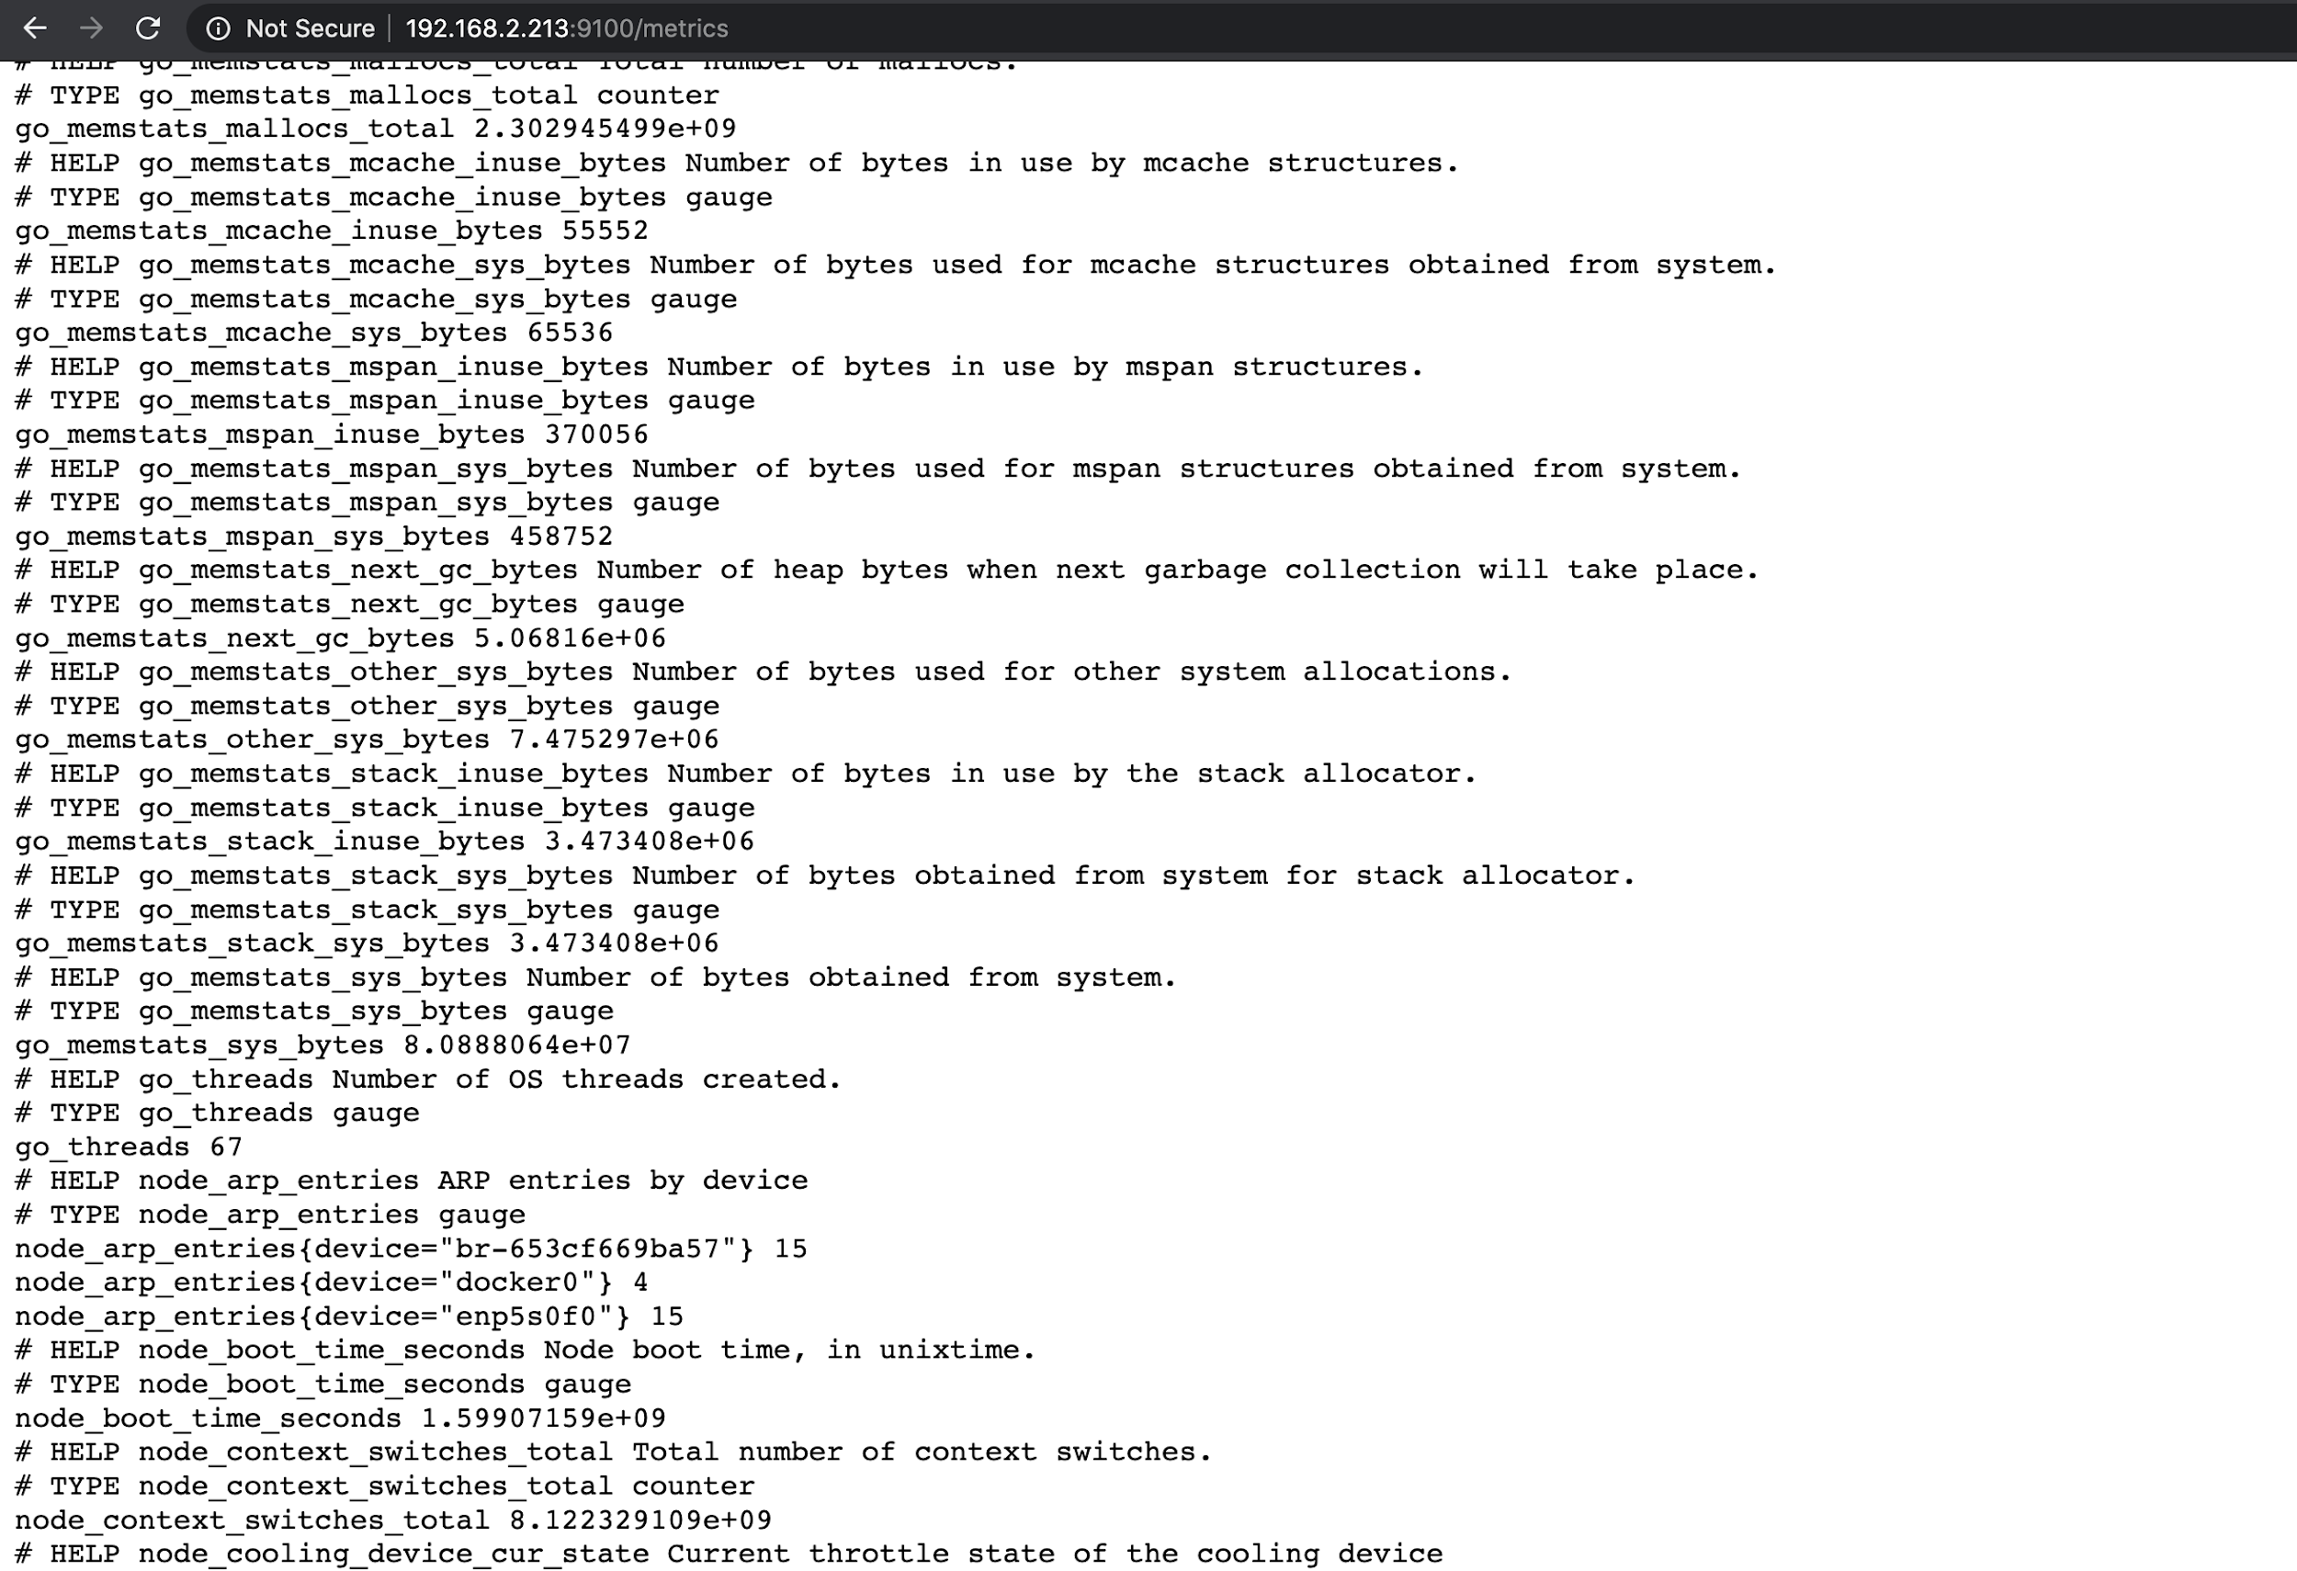

Slide 17
Prometheus Data Model
Timeseries
<identifier> → [ (t0, v0), (t1, v1), … ]
What is this? int64 float64

Slide 18
Prometheus Data Model
tns_request_duration_seconds_count
Metric name

Slide 19
Prometheus Data Model
tns_request_duration_seconds_count{job="tns-app", status_code=”503”}
Metric name Labels

Slide 20
Cardinality
Datacenter, methods, etc. ✅
IP address, users, etc. 🙅‍♂️

Slide 21
Prometheus Data Model
float64
tns_request_duration_seconds_count{job="tns-app", status_code=”503”} 24
Metric name Labels

Slide 22

Prometheus Architecture
Instrumentation & Exposition
Targets
web app
clientlib
API server
clientlib
Linux VM
exporter
mysql
exporter
Windows VM
exporter

Slide 23
Prometheus Architecture
Instrumentation & Exposition
Instrumentation & Exposition
Targets
web app
clientlib
API server
clientlib
Prometheus
Linux VM
exporter
TSDB
mysqld
exporter
cgroups
exporter
Collection, Storage & Processing

Slide 24
Prometheus Architecture
Instrumentation & Exposition
Targets
Service Discovery (DNS, Kubernetes, AWS, Consul, custom...)
web app
clientlib
API server
clientlib
Prometheus
Linux VM
exporter
TSDB
mysqld
exporter
cgroups
exporter
Collection, Storage & Processing
Collection, Storage & Processing
Collection, Storage & Processing

Slide 25

Prometheus Architecture
Instrumentation & Exposition
Targets
Service Discovery (DNS, Kubernetes, AWS, Consul, custom...)
Targets
web app
clientlib
API server
clientlib
Prometheus
Grafana Web UI
Linux VM
exporter
TSDB
mysqld
exporter
cgroups
exporter
Querying, Dashboards
Collection, Storage & Processing
Collection, Storage & Processing
Collection, Storage & Processing
Collection, Storage & Processing

Slide 26
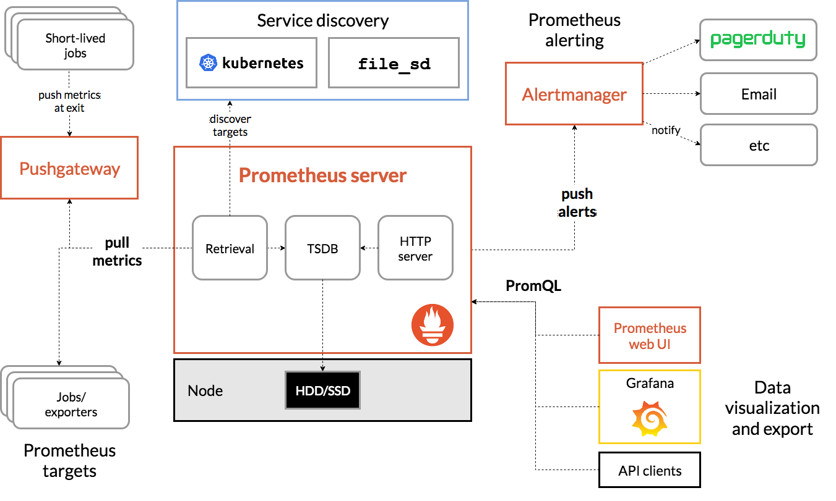

Slide 27
Poll Q

Slide 28
Installing Prometheus

Slide 29
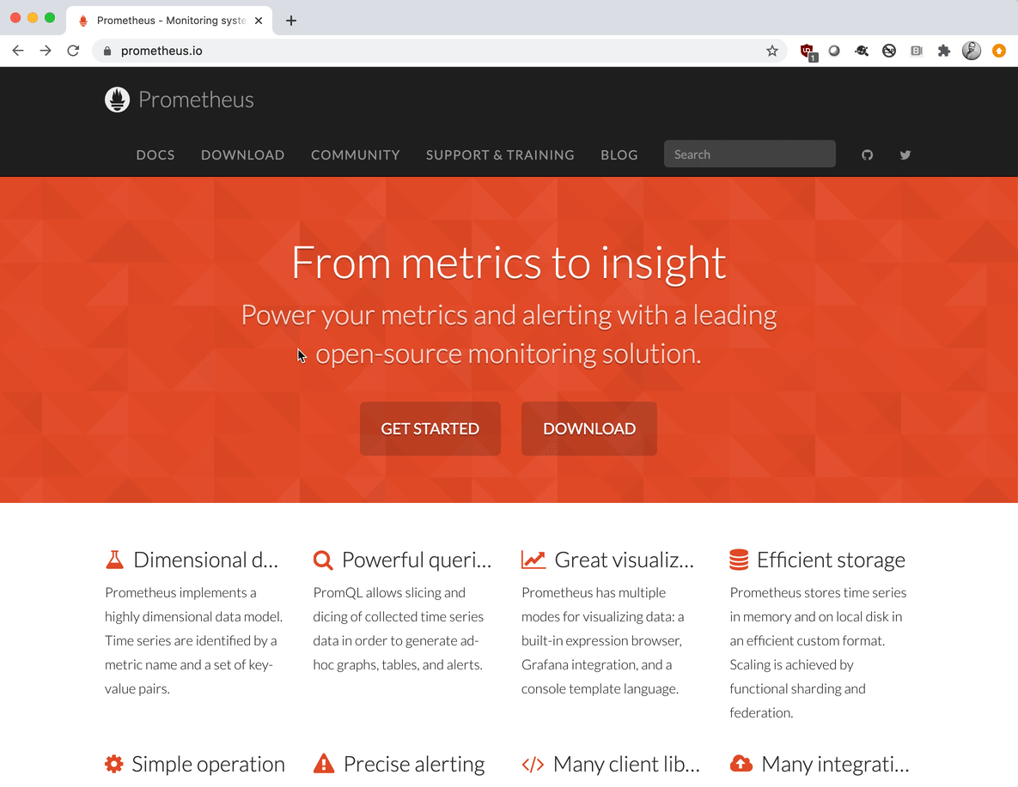
prometheus.io

Slide 30
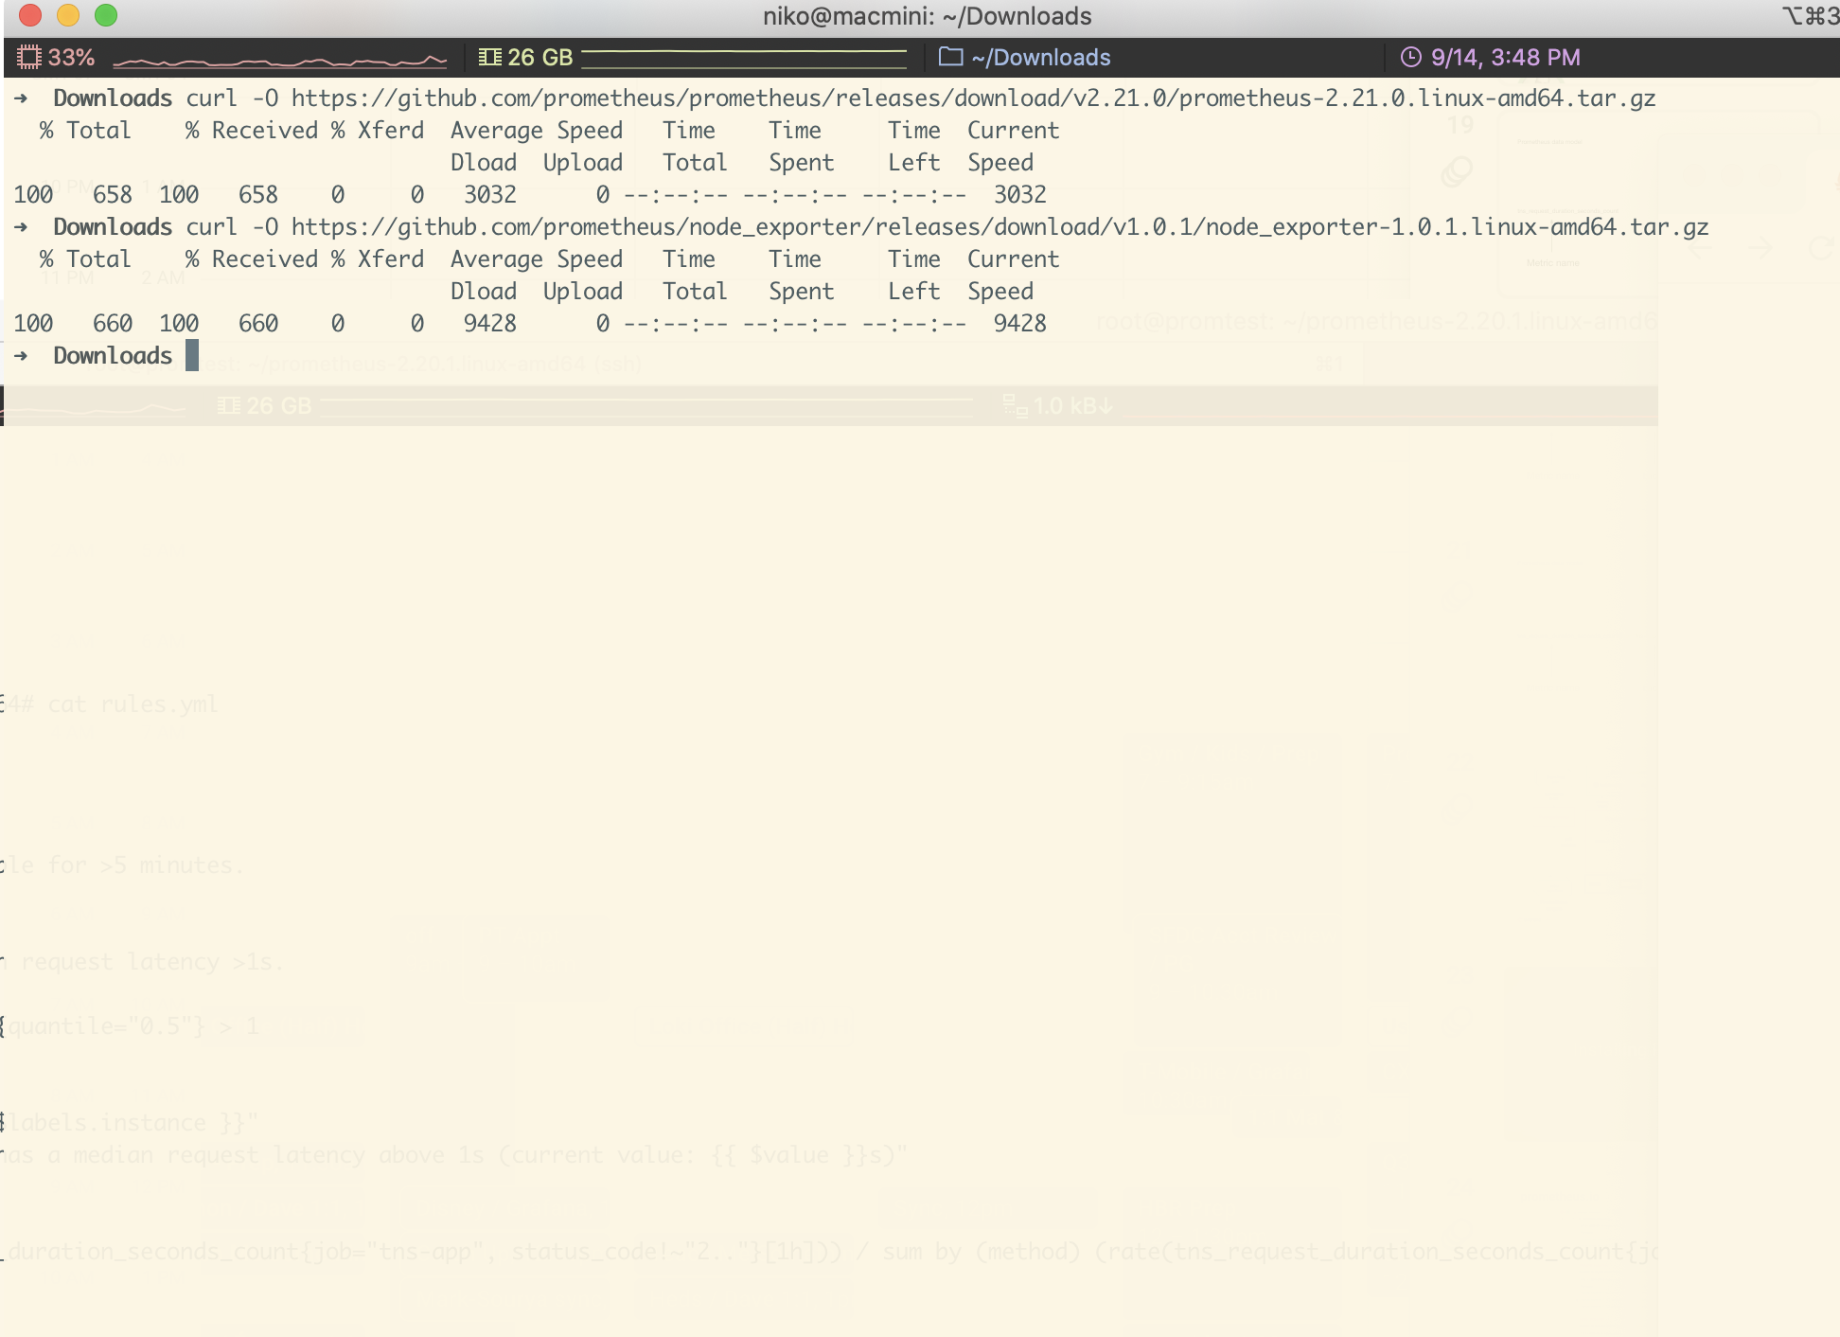
Get and Untar

Slide 31
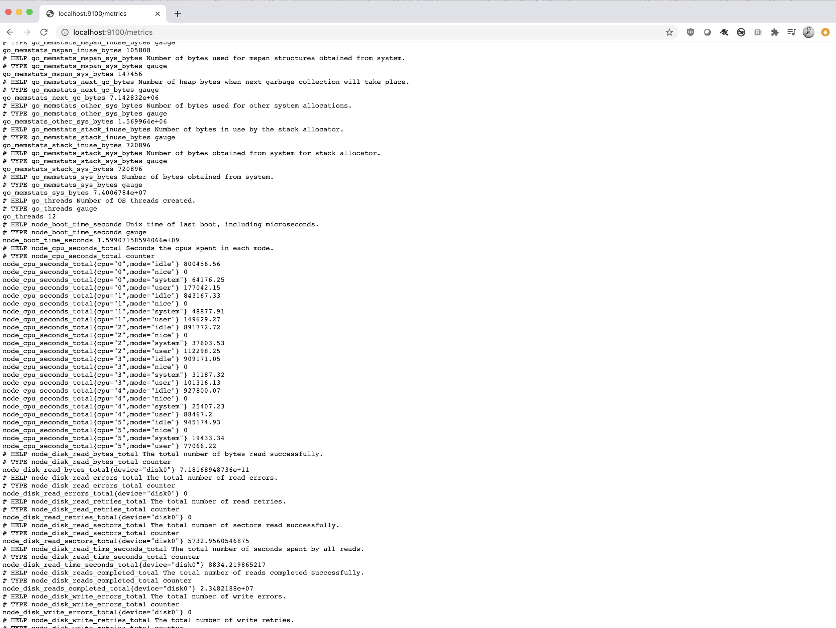
Start Node Exporter

Slide 32
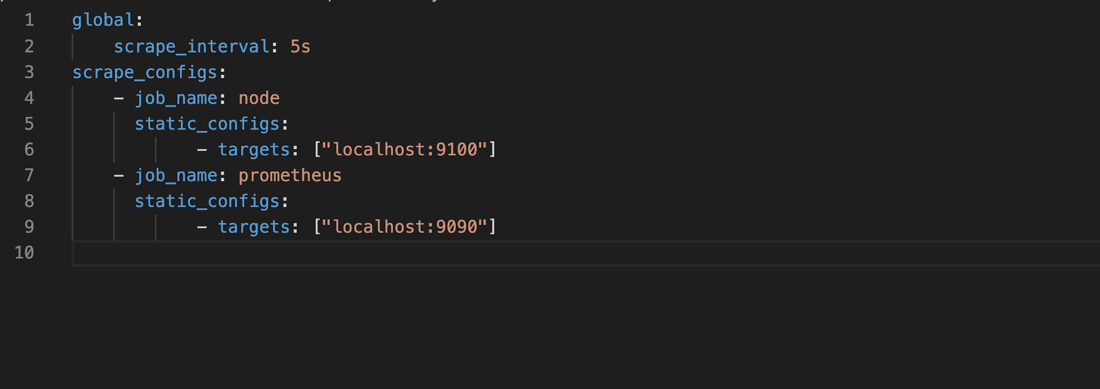
prometheus.yml

Slide 33
Prometheus UI
Breakout

Slide 34
Poll Q

Slide 35
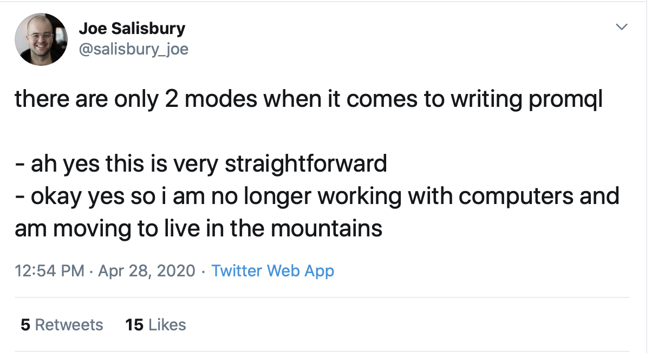
PromQL

Slide 36
PromQL Data Types
Strings
Scalars
Instant vectors
Range vectors

Slide 37
PromQL Data Types
Instant vectors:
prometheus_http_requests_total

Slide 38
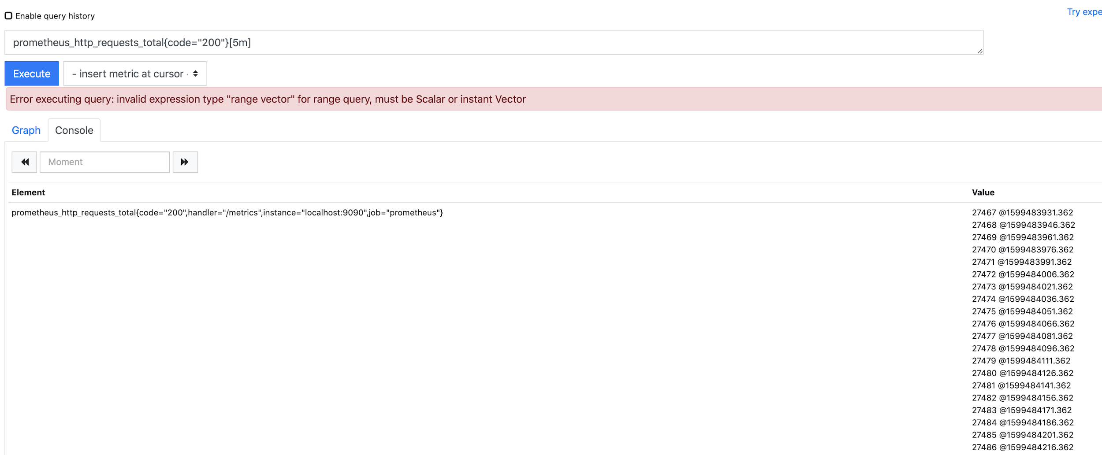
Range vectors
prometheus_http_requests_total{code="200"}[5m]

Slide 39
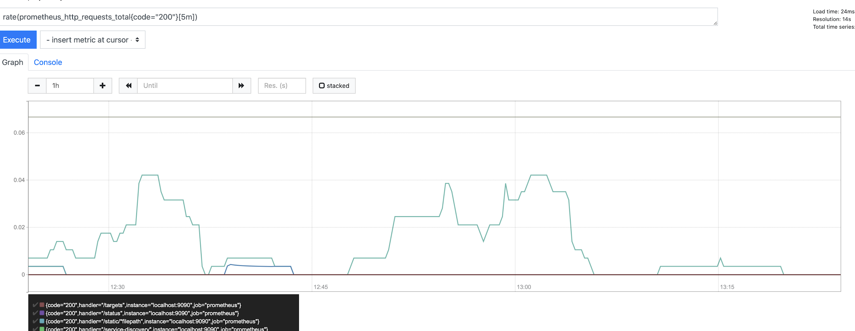
rate()
Range vectors
prometheus_http_requests_total{code="200"}[5m]

Slide 40
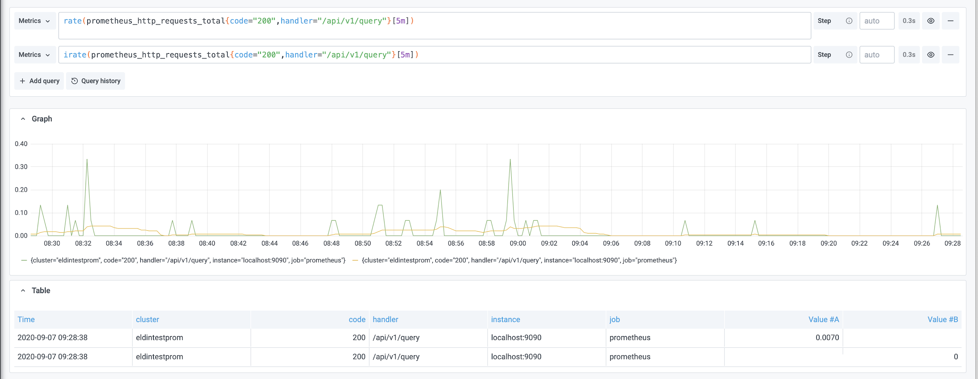
rate() vs. irate()
Range vectors
prometheus_http_requests_total{code="200"}[5m]

Slide 41




PromQL Metric Types
Counters
Gauges
Histograms
Summary

Slide 42
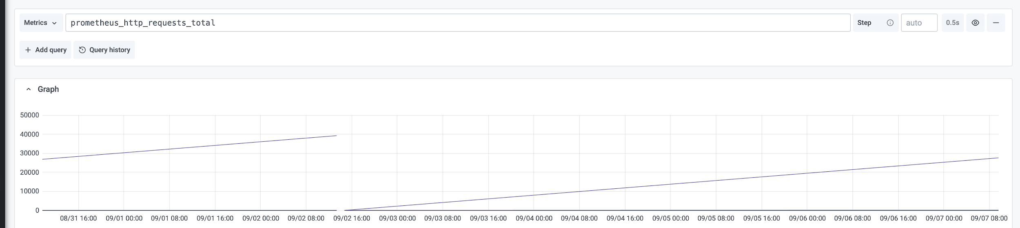
Counters

Slide 43
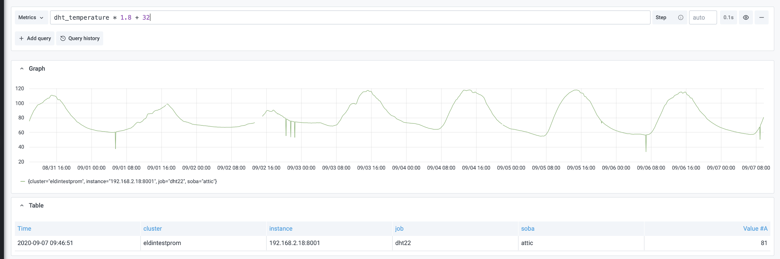
Gauges

Slide 44
Histogram
# TYPE prometheus_http_request_duration_seconds histogram
prometheus_http_request_duration_seconds_bucket{handler="/",le="0.1"} 100
prometheus_http_request_duration_seconds_bucket{handler="/",le="0.2"} 200
prometheus_http_request_duration_seconds_bucket{handler="/",le="0.4"} 300
prometheus_http_request_duration_seconds_bucket{handler="/",le="1"} 400
prometheus_http_request_duration_seconds_bucket{handler="/",le="+Inf"} 1000
prometheus_http_request_duration_seconds_sum{handler="/"} 0.0005965400000000001
prometheus_http_request_duration_seconds_count{handler="/"} 1000

Slide 45
Summary
# HELP prometheus_tsdb_wal_fsync_duration_seconds Duration of WAL fsync.
# TYPE prometheus_tsdb_wal_fsync_duration_seconds summary
prometheus_tsdb_wal_fsync_duration_seconds{quantile="0.5"} NaN
prometheus_tsdb_wal_fsync_duration_seconds{quantile="0.9"} NaN
prometheus_tsdb_wal_fsync_duration_seconds{quantile="0.99"} NaN
prometheus_tsdb_wal_fsync_duration_seconds_sum 0.076174204
prometheus_tsdb_wal_fsync_duration_seconds_count 58
rate(prometheus_tsdb_wal_fsync_duration_seconds_count[5m])
rate(prometheus_tsdb_wal_fsync_duration_seconds_sum[5m])

Slide 46
PromQL: Binary Operators
Arithmetic
+ (addition)
- (subtraction)
* (multiplication)
/ (division)
% (modulo)
^ (exponentiation)

Slide 47
Operators

Slide 48
PromQL: Binary Operators
Arithmetic
+ (addition)
- (subtraction)
* (multiplication)
/ (division)
% (modulo)
^ (exponentiation)
Comparison
== (equal)
!= (not-equal)
> (greater-than)
< (less-than)
>= (greater-or-equal)
<= (less-or-equal)
Binary logic
and (intersection)
or (union)
unless (complement)

Slide 49
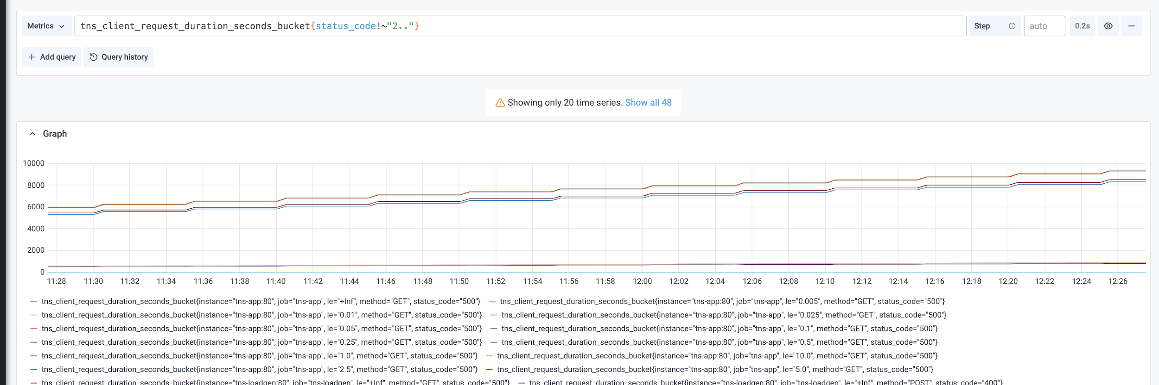
Label Matching Operators

Slide 50
Aggregation operators
sum (calculate sum over dimensions) min (select minimum over dimensions) max (select maximum over dimensions) avg (calculate the average over dimensions) stddev (calculate population standard deviation over dimensions) stdvar (calculate population standard variance over dimensions) count (count number of elements in the vector) count_values (count number of elements with the same value) bottomk (smallest k elements by sample value) topk (largest k elements by sample value) quantile (calculate φ-quantile (0 ≤ φ ≤ 1) over dimensions)

Slide 51
PromQL & Dashboarding
Breakout

Slide 52
Alerting

Slide 53

The Four
Golden Signals

Slide 54
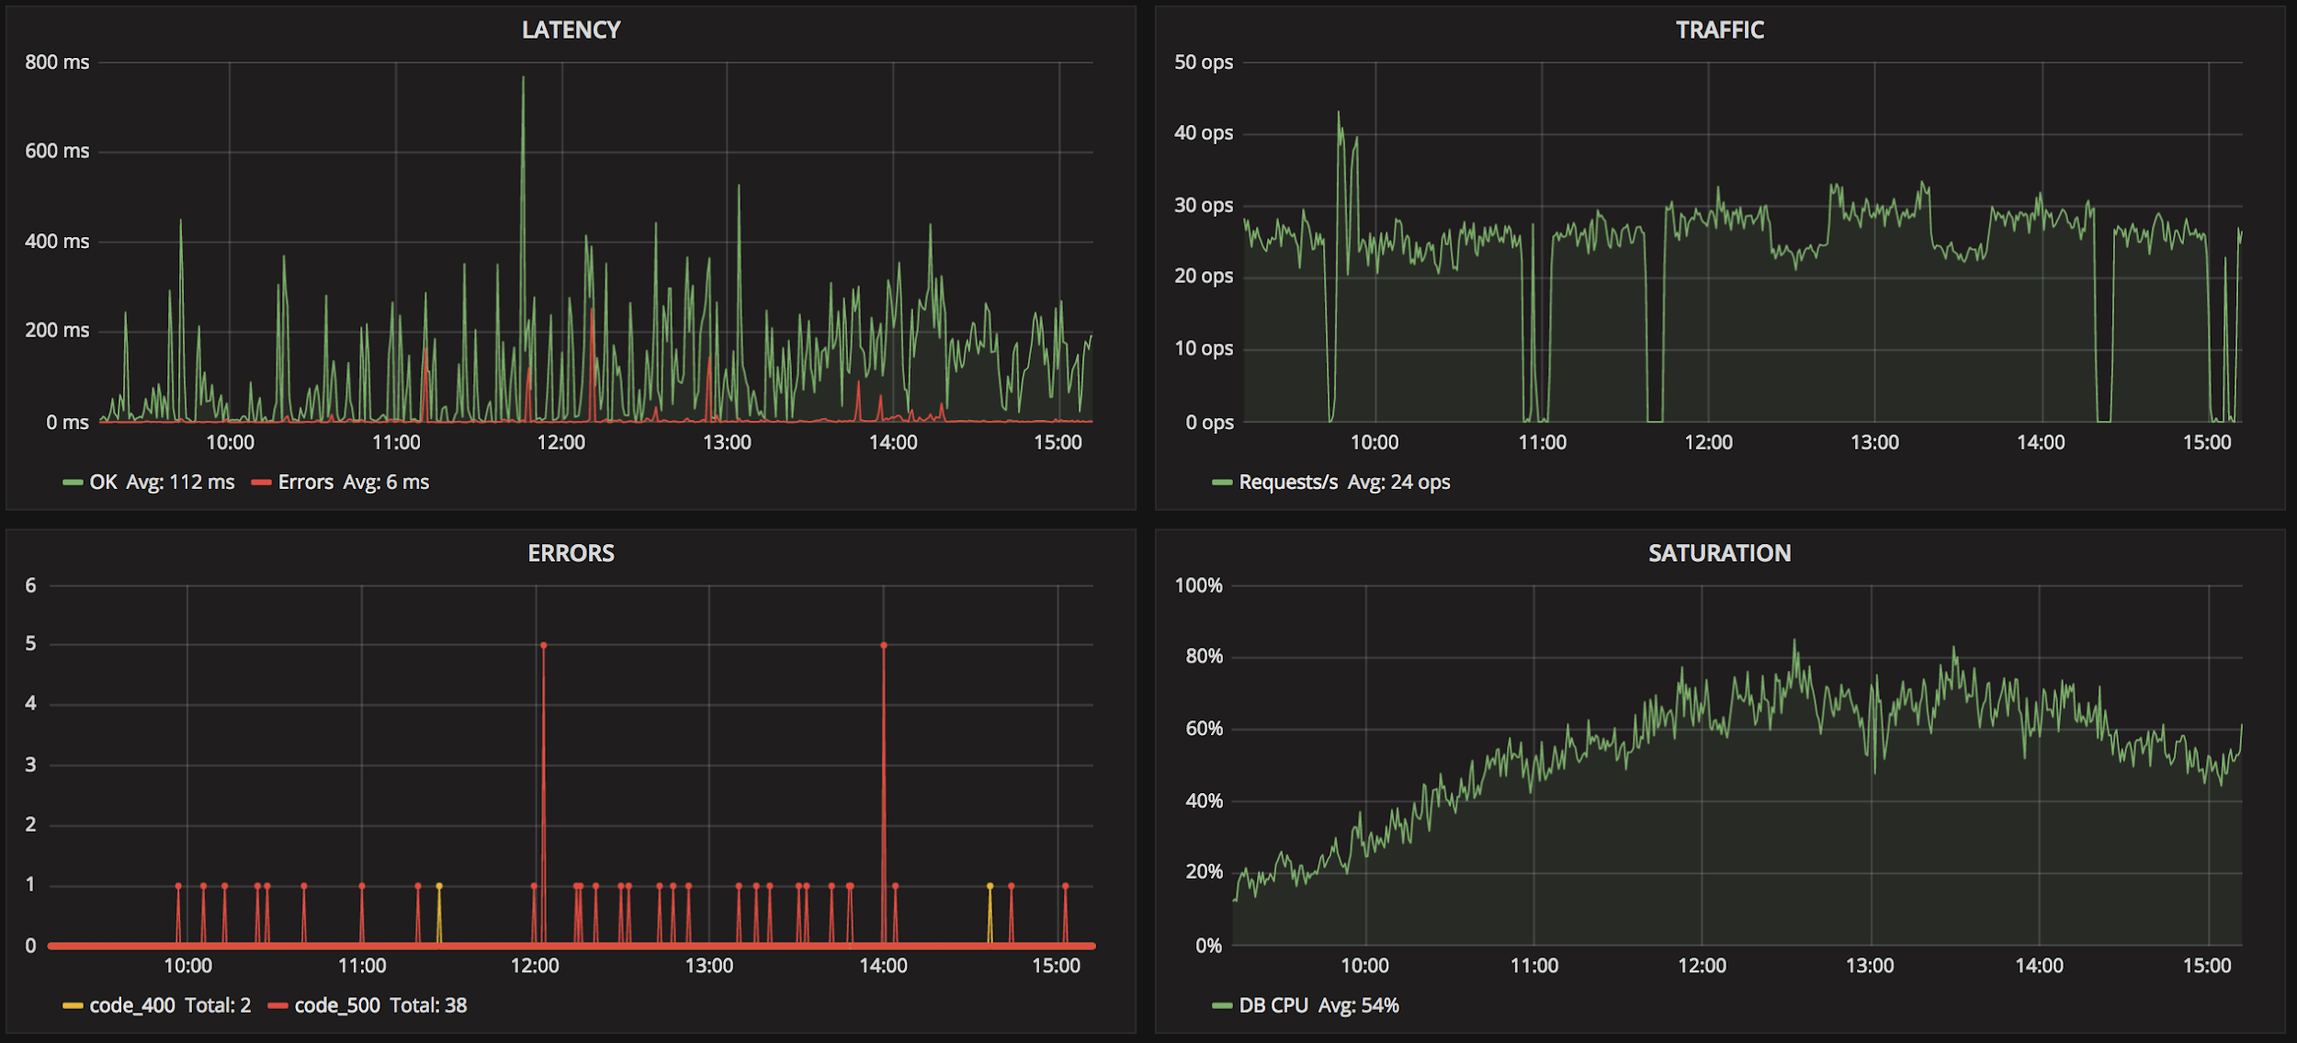
The Four
Golden Signals

Slide 55
USE Method and RED Method
Utilization (U): the proportion of the resource that is used
Saturation (S): A measure of how “full” a service is, often measured by latency.
Errors (E): the count of error events or rate of failed requests.
Rate (R): The number of requests per second.
Errors (E): The number of failed requests.
Duration (D): The amount of time to process a request.
The RED method: How to instrument your services

Slide 56
Alertmanager
Separate component that sits alongside Prometheus
Handles alerts received from Prometheus (built-in alerting)

Slide 57
What Does Alertmanager Do?
🤲 Receive Alerts
📦 Group them
🤫 Silence them
🔒 Inhibit them

Slide 58
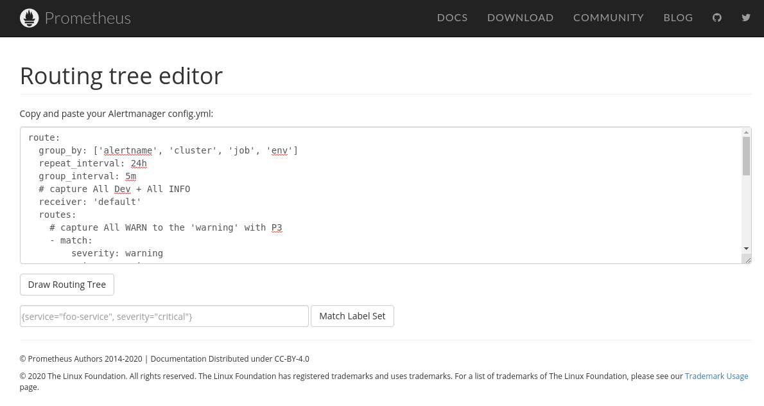
What Does Alertmanager Do?
📨 Routes them
Determines who should receive an alert
Sends them along to a notification channel
E.g. email, Slack, PagerDuty, etc.
Webhooks
Has a “UI”

Slide 59

What Does Alertmanager Do?
📥 Deduplication
🔃 Provide High Availability (HA)

Slide 60
sum by (method) (rate(tns_request_duration_seconds_count{job="tns/app", status_code!~"2.."}[1h])) /
sum by (method) (rate(tns_request_duration_seconds_count{job="tns/app"}[1h])) > 0.1

Slide 61
How?
- alert: requestratetns
expr: sum by (method) (rate(tns_request_duration_seconds_count{job="tns-app", status_code!~"2.."}[1h]))
/ sum by (method) (rate(tns_request_duration_seconds_count{job="tns-app"}[1h])) > 0.1
for: 1m
labels:
severity: critical
annotations:
summary: "SLO breach (job {{ $labels.method }})"
description: ">10% of requests are failing \n VALUE = {{ $value }}\n LABELS: {{ $labels }}"

Slide 62
Scaling

Slide 63
Prometheus HA

Slide 64
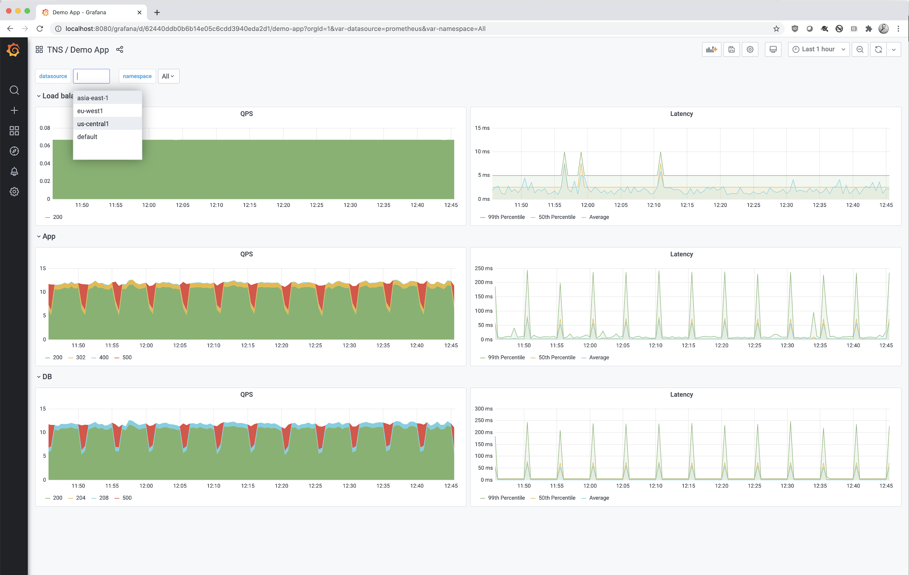
Scaling
eu-west-1
us-central-1
asia-east-1

Slide 65
Federation or…
Global Federation
eu-west-1
us-central-1
asia-east-1

Slide 66

Central Cortex Cluster
eu-west-1
us-central-1
asia-east-1

Slide 67
Summary
Prometheus
Simple to operate
Powerful & concise query language
Fantastic service discovery
Grafana Dashboards
Easy to get started using Grafana Cloud
https://grafana.com/grafana/dashboards

Slide 68
GME Announcement
Join us for a special announcement about our latest product offering, Grafana Metrics Enterprise (GME) after this workshop @ 12:30 EST.
Join Tom Wilkie and Matt Mendick for this webinar, where they’ll cover:
Challenges when it comes to securing and monitoring Prometheus in the enterprise
Different ways Grafana Labs can help centralize metrics and management with Grafana Metrics Enterprise
New features available in GME and how to get access
A live product demo so you can see GME for the first time
The registration link in is the Zoom chat now! (also available on-demand after today)

Slide 69






Goutham Veeramachaneni

Slide 70
Q&A
Thank You

